Slide 1
Lawn Buddy
“The cutting hedge technology”
Gasser Ahmed
MGT 5804: AI Automation Project
5/1/2023

Slide 2

Company Description
Lawn Buddy is a startup company operating a lawn service platform that allows lawn owners to:
Input information about their lawn with the help of machine learning and image processing to help identify what services the lawn needs most
Schedule and confirm lawn service appointment
Mission Statement: Lawn Buddy is on a mission to provide expertise lawn care services for everyone, everywhere. We strive for innovation by providing services at the touch of a button.
Vision and Goals: At Lawn Buddy our vision is to service all communities, all over the country in order to provide lawn care for all types of localities. We want to build a place where people can mutually recognize the ethics of environmental care and community engagement.

Slide 3
Customer Segmentation Strategy

Slide 4
AI/Data Strategy

Slide 5








Value Network
Homeowner
Home Improvement Stores
Data Analytics
Homeowners Insurance
Enable secured payment transactions between homeowners and lawn professionals
Use tool to confirm appointments and provide reports about services
Credit Payment Service
Lawn Professional
Use tool to provide information about lawn, schedule appointment, and confirm payments
Enable new lawn mowing services/products to lawn professionals
Lawn Buddy App
Sell data to third parties for research and additional Services
Reduce lawn care costs by paying for lawn damage caused by an earthquake or a flood
AI Engineer
Other
Analyze data to provide algorithms improvements and service solutions
Use app to promote and sell other services to stakeholders
Notes:
Icons: https://icons8.com

Slide 6
Homeowner
Home Improvement Stores
Data Analytics
Homeowners Insurance
Enable secured payment transactions between homeowners and lawn professionals
Use tool to confirm appointments and provide reports about services
Credit Payment Service
Lawn Professional
Use tool to provide information about lawn, schedule appointment, and confirm payments
Enable new lawn mowing services/products to lawn professionals
Lawn Buddy App
Sell data to third parties for research and additional Services
Reduce lawn care costs by paying for lawn damage caused by an earthquake or a flood
AI Engineer
Other
Analyze data to provide algorithms improvements and service solutions
Use app to promote and sell other services to stakeholders

Slide 7
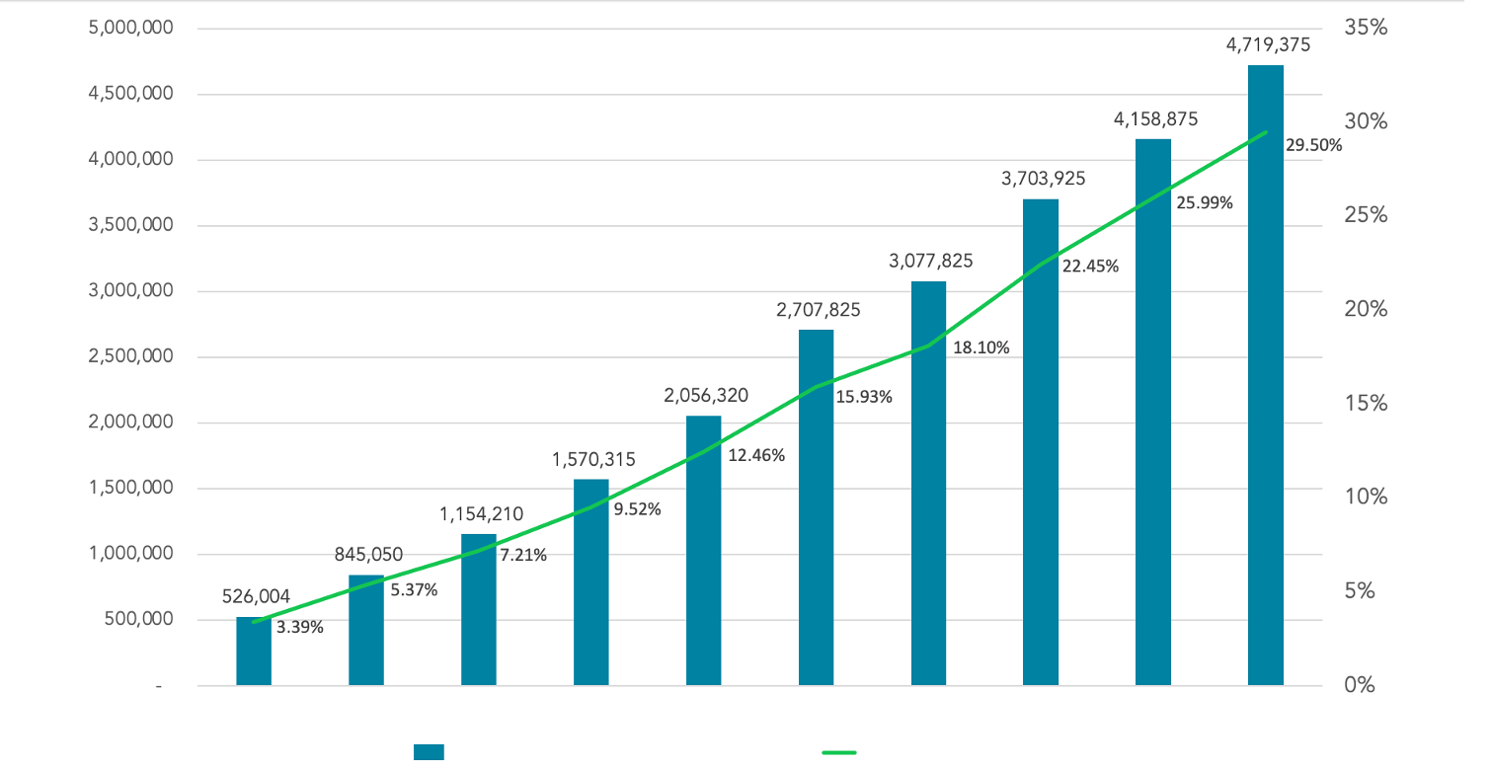
Finances
2023
2024
2025
2026
2027
2028
2029
2030
2031
2032
Lawn Buddy Annual Sales
Lawn Buddy Sales Share
Notes:
Icons: https://icons8.com

Slide 8







Executive Summary
About Us
Mission & Vision
Competition
A lawn service platform to connect individuals to their community.
Providing expertise lawn care services for everyone, everywhere.
A pioneering idea, a first of its kind. We actively implement ease and efficiency and in return customer satisfaction.
Marketing Plan
Operating Plan
Financial Plan
Targeting all people e.g., busy, physically unable to provide care of their lawn, do not have lawn care tools, and tech enthusiasts.
Production will be covered in house with overall cost of $60,000.
Annual startup expenses: $855,653.00
6-month sales projection: $441,000.00
Breakeven sales level: $67,752.00
Enaas Ahmad, CEO Leading industry expertise in founding numerous companies in domestic and international marketplaces.
Gasser Ahmed, CTO Superior expertise with development methodologies, developer supervision, and client relations.
Hamnah Rizwan, CFO Highly regarded expertise in driving complex strategic initiatives, M&A activities, and financial operations for multibillion-dollar, multinational corporations
Team

Slide 9
Service
Lawn Buddy provides the service of enabling access and opportunity for lawn care services to individuals. By simply logging into the app and enabling your location.
The app is programmed to find lawn care professionals near you. By using the filtering menu you can choose your price range, experience level, and scheduling preferences, so you can find the lawn professionals that fit your exact needs.
After selecting your lawn professional, and appointment time, then provide information about your lawn. By inputting your information about lawn size, terrain type, and other services required like hedging or trimming, then we can estimate a cost.
Lastly, by finalizing a date and time, then you can relax and have the lawn maintained for you. Although we can guarantee that you will be impressed with the services that Lawn Buddy has provides, tipping services and review platforms are available where you can show gratitude to your lawn professional. The final cost will include the lawn size per square foot, and time and a service fee depending on your location.
Final Cost = ($11 x Hours) + 10% Service Fee + ($0.05 x Sqft)
Value Proposition: At Lawn Buddy with one tap the lawn professional comes to you, knows exactly what needs to be done, and the process is completely contact free, including the payment.

Slide 10
Marketing Plan
Competitors: Lawn Buddy is a pioneering idea, a first of its kind. Our niche is to tackle real world problems by implementing innovative and futuristic technology in the lawn care industry. By mobilizing lawn maintenance, we actively implement ease and efficiency and in return customer satisfaction.
Target Audience: We strive to provide our services to all people, everywhere. We know that some are busier than others and do not have time to dedicate to lawn maintenance, those are ideal customers that would have a need to avail our customers. As well as those that are physically unable to provide care to their lawn like the elderly, sick individuals or disabled persons. Including customers that do not have lawn care tools and seek lawn services. Lastly, tech enthusiasts that implement innovativeness and hope to simplify everyday tasks.
Advertisement: Lawn Buddy’s advertisements will be displayed on social media as well as similar service-type applications.
“The average American spends about 70 hours a year on lawn and garden care, according to the American Time Use Survey.”

Slide 11
Operating Plan
Production
Quality
Partners
Production will be covered in house
Overall cost of production/development: $60,000 (app)
Monthly subscription-based (lawn mowing companies, $50/month/contractor) & 5% of sales
Monitor the marketplace (reviews by customers)
Automated Testing
Frequent Testing
Crowdsourcing Testing
Contractors (lawn mowing companies & individuals)

Slide 12
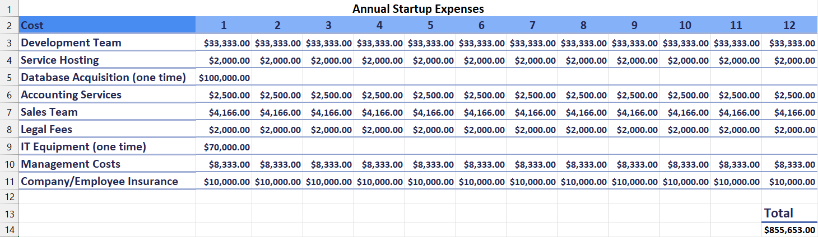
Financial Plan: Startup Expenses

Slide 13
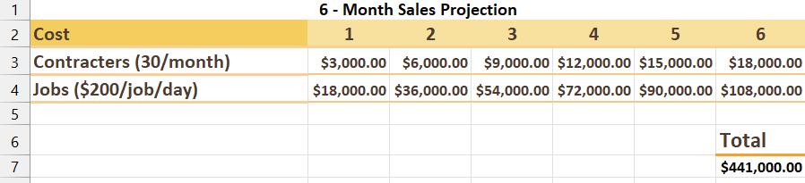
Financial Plan: Sales Projection
Cash Flow: negative first month, more profitable each month after

Slide 14
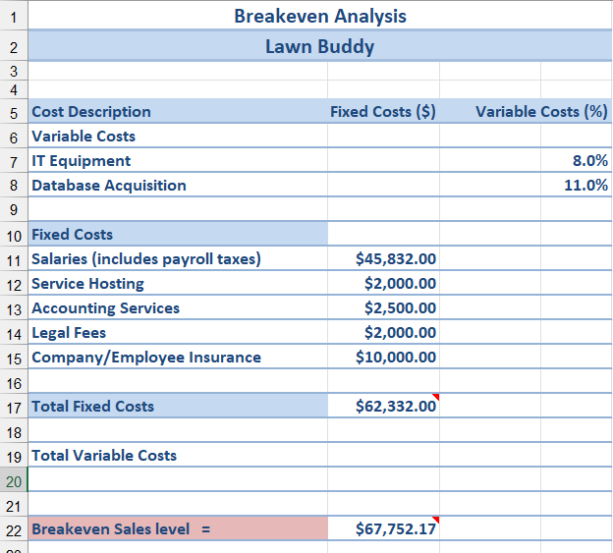
Financial Plan: Break-even

Slide 15
Lean Startup
Leap of Faith Assumptions
Metrics
Minimum Viable Product
Customers will use an app specialized in finding lawn mowing services
Contractors will want to pay to be listed on our platform
Customers will share our app through contacts and social media
Social Media
Google Analytics
Automation
User Reviews
Lawn buddy provides a minimal viable product—providing lawn services from your phone with a touch of a button
Login into Lawn Buddy
Find a lawn professional near you
Enjoy your fresh cut grass
“The average American also takes three hours a week just thinking about their lawn. The survey also found that while Americans take pride in their lawn and yard work, there are just some tasks that they just plain don't like.”

Slide 16


Technology
Development
Marketing
MERN stack
Analytics, email, social media, and automation
“The lawn care industry is enjoying a period of consistent growth. From 2016 to 2021, the industry has grown 5.1% per year on average. In 2021, the industry was expected to grow by 5.3%, higher than the country’s overall economic growth.”

Slide 17
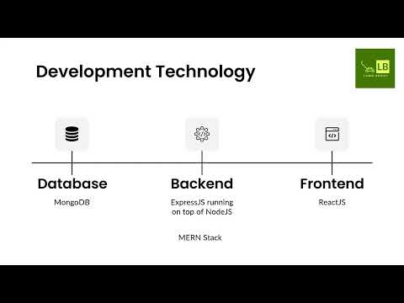

Slide 18




Marketing Technology
Analytics
Email
Social Media
Automation
Google Analytics
MailChimp
Hootsuite
HubSpot

Slide 19
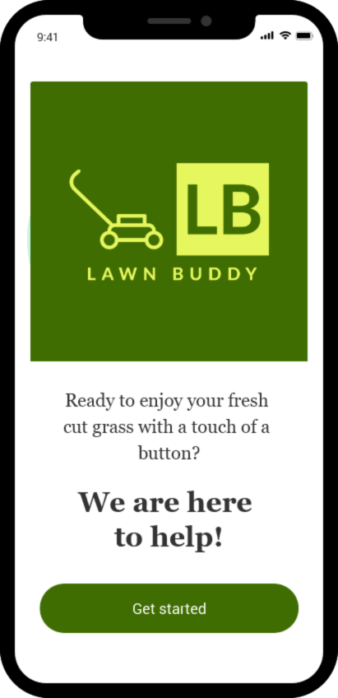
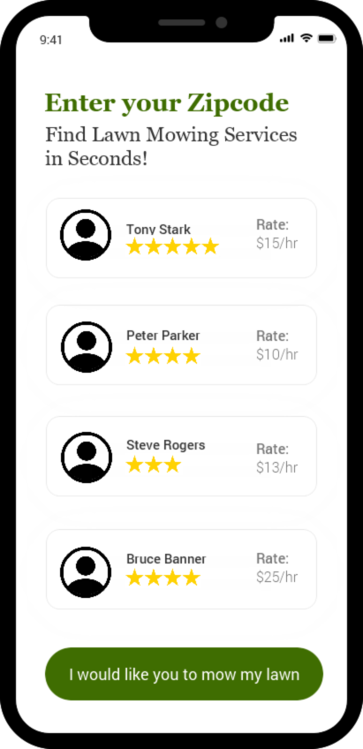
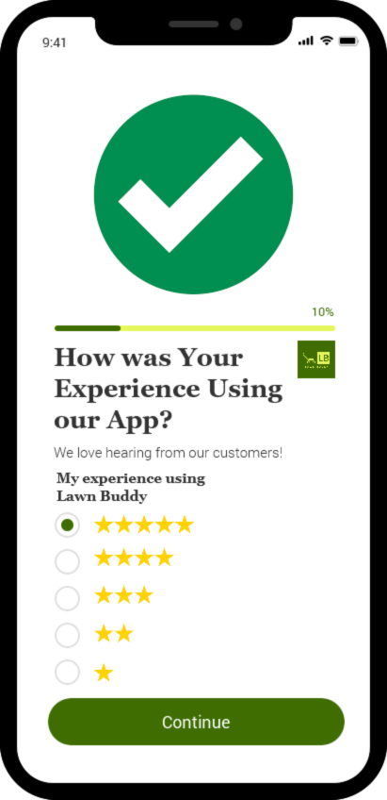
App Wireframe

Slide 20
Sources
https://www.homewyse.com/services/cost_to_mow_lawn.html
https://www.thedroidsonroids.com/blog/quality-assurance-mobile-web-app-development-process
https://spdload.com/blog/app-development-cost/
https://www.usertesting.com/blog/how-to-implement-the-lean-startup-at-large-organizations#:~:text=Leap%2Dof%2Dfaith%20assumptions%20are,share%20it%20with%20their%20friends
https://krify.co/ultimate-guide-to-design-and-develop-a-web-or-mobile-minimum-viable-product/
https://www.usertesting.com/blog/how-to-implement-the-lean-startup-at-large-organizations#:~:text=Leap%2Dof%2Dfaith%20assumptions%20are,share%20it%20with%20their%20friends
https://krify.co/ultimate-guide-to-design-and-develop-a-web-or-mobile-minimum-viable-product/
https://dev.to/theme_selection/best-web-development-stack-2jpe
https://hbr.org/2014/11/7-marketing-technologies-every-company-must-use
https://www.method.me/blog/lawn-care-industry-stats/

